Slide 1
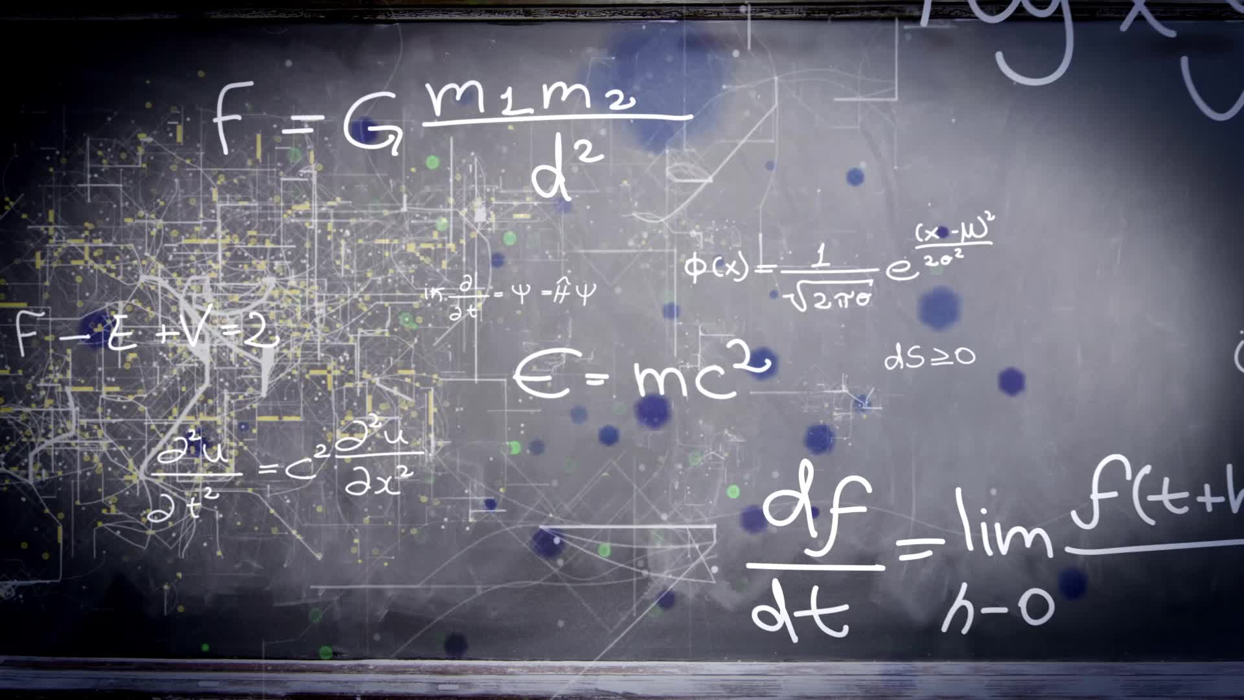
Chapter P.3:
FUNCTIONS AND THEIR GRAPHS
HONORS CALCULUS/CALCULUS

Slide 2
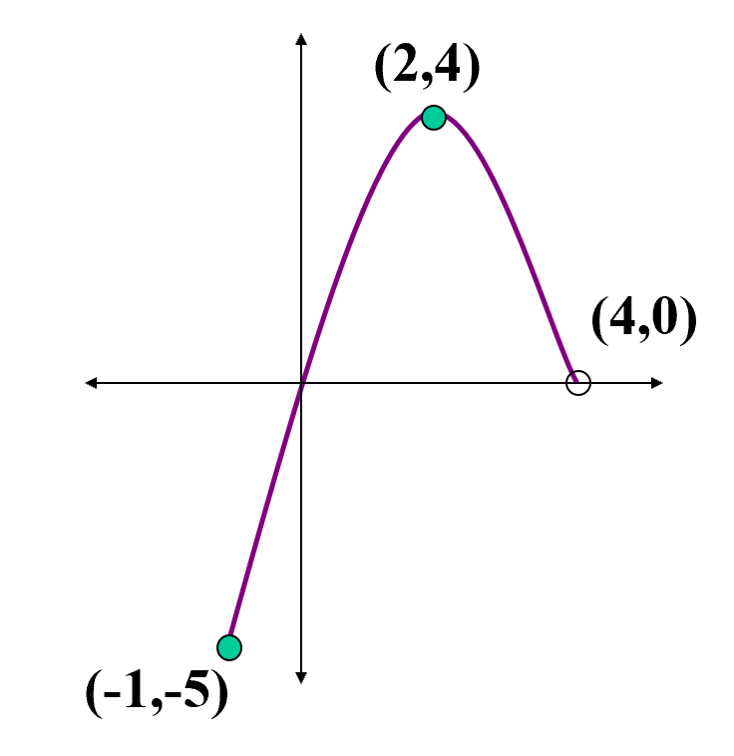






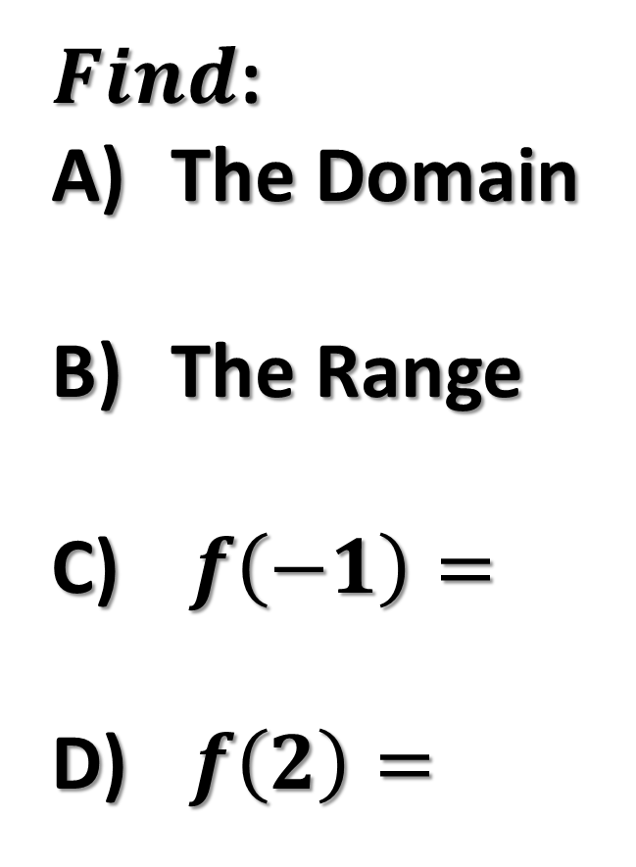
Ex. 1)
$Find$:
The Domain
The Range
$f\left(−1\right)=$
$f\left(2\right)=$

Slide 3
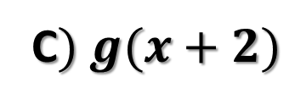












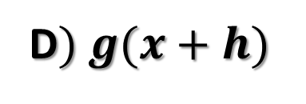
Ex. 2)
$$g\left(x\right)=−x^{2}+4x+1$$
FIND:
$$A) g(2)$$
B$) g(t)$
C$) g(x+2)$
D$) g(x+h)$

Slide 4










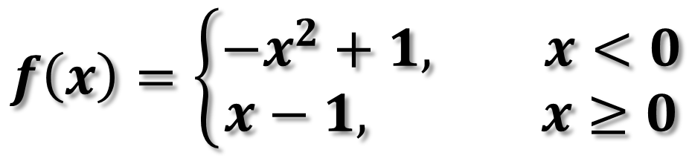












Ex. 3)
$$f\left(x\right)=\left\{\begin{aligned}−x^{2}+1, x<0 \\ &x−1, x≥0\end{aligned}\right.$$
$$Evaluate x= −1,0,1$$

Slide 5
















Ex. 4)
$$f\left(x\right)=3x−1$$
$$Find \frac{f\left(x+h\right)−f(x)}{h}$$

Slide 6
























Ex. 5)
$$f\left(x\right)=x^{2}−4x+7$$
$$Find \frac{f\left(x+h\right)−f(x)}{h}$$

Slide 7
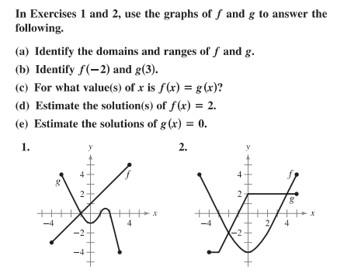

Slide 8
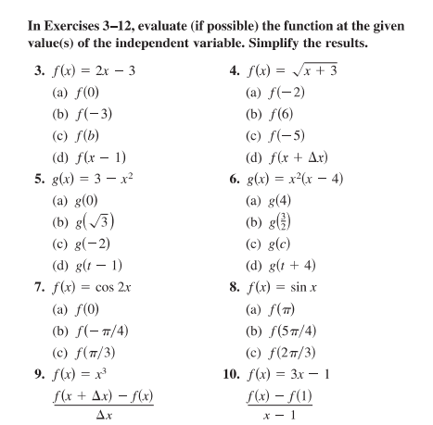

Slide 9
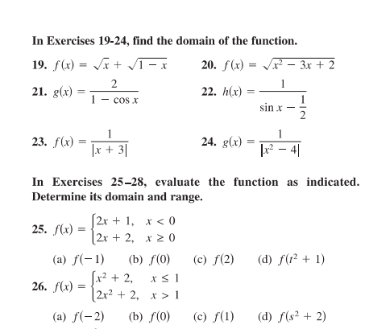

Slide 10
FUNCTIONS
FUNCTION: For every x there is exactly one y
DOMAIN: set of x-values
RANGE: set of y-values

Slide 11
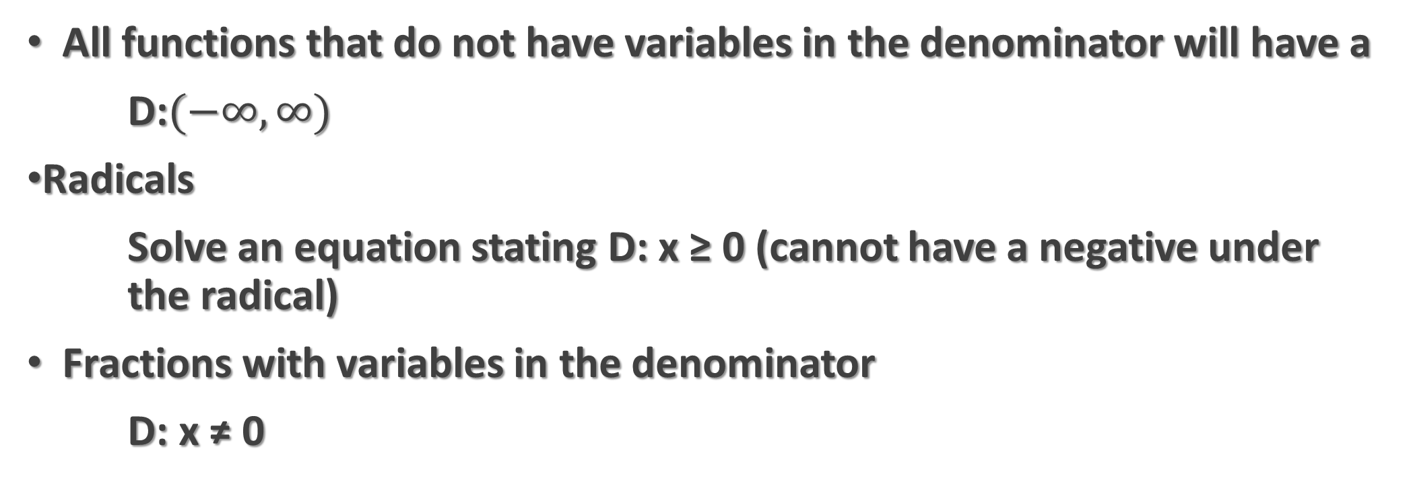


Domain Helpful Hints
All functions that do not have variables in the denominator will have a
D:$(−∞,∞)$
Radicals
Solve an equation stating D: x ≥ 0 (cannot have a negative under the radical)
Fractions with variables in the denominator
D: x ≠ 0

Slide 12
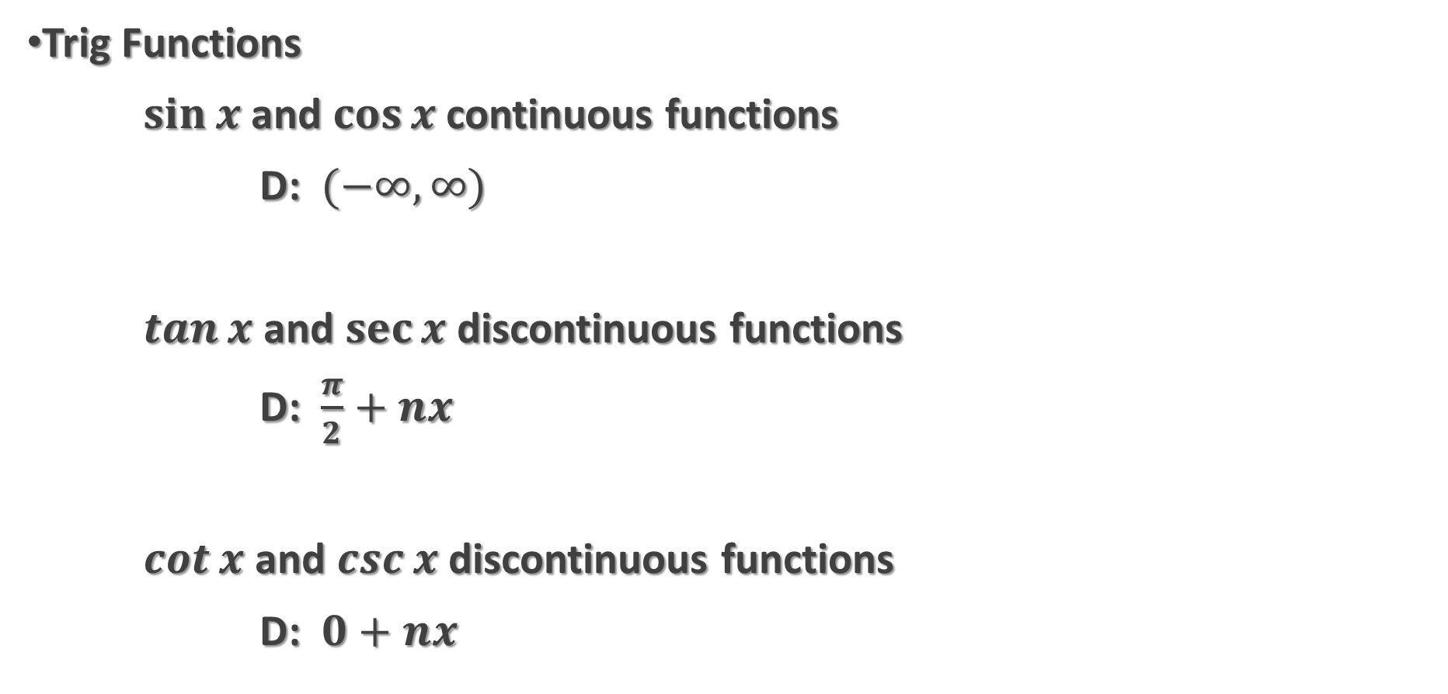
Domain Helpful Hints
Trig Functions
$\sin{x}$ and $\cos{x}$ continuous functions
D: $(−∞,∞)$
$\tan{x}$ and $\sec{x}$ discontinuous functions
D: $\frac{π}{2}+nx$
$\cot{x}$ and $\csc{x}$ discontinuous functions
D: $0+nx$

Slide 13
RANGE
Values y takes on
It can be helpful to solve for y
Use logic
Apply what you know about the domain

Slide 14





















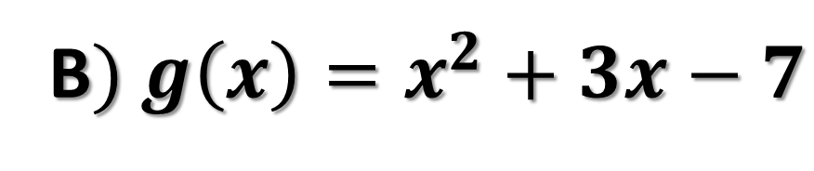


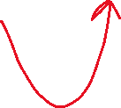





Ex. 1)
$$Find the domain and range$$
$$A) f:\{\left(−3,0\right), \left(−1,4\right),\left(0,2\right),\left(2,2\right),\left(4,1\right)\}$$
B$) g\left(x\right)=x^{2}+3x−7$

Slide 15






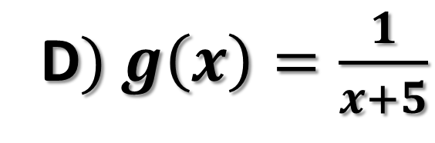





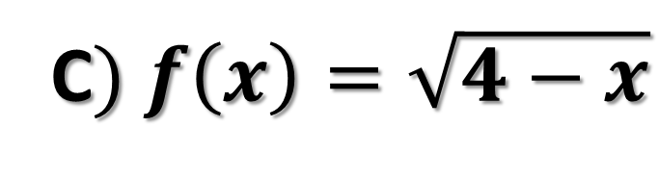
Ex. 2)
$$Find the domain and range$$
C$) f\left(x\right)=\sqrt{4−x}$
D$) g\left(x\right)=\frac{1}{x+5}$

Slide 16
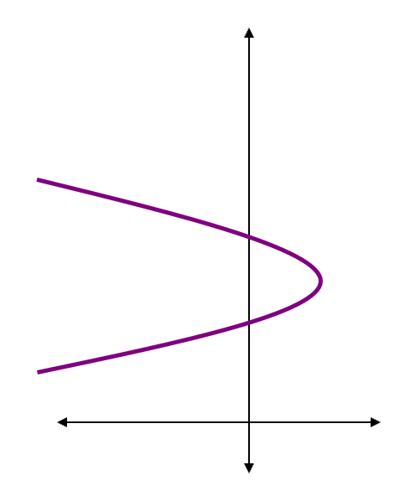
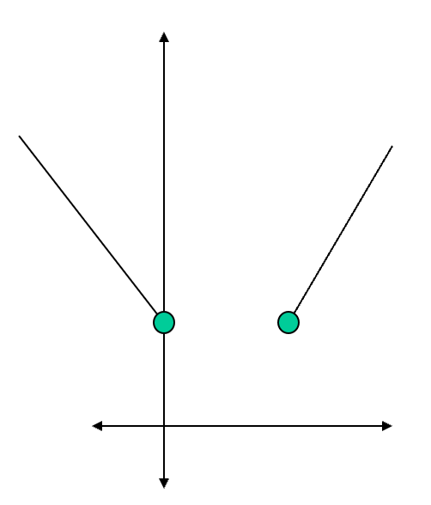
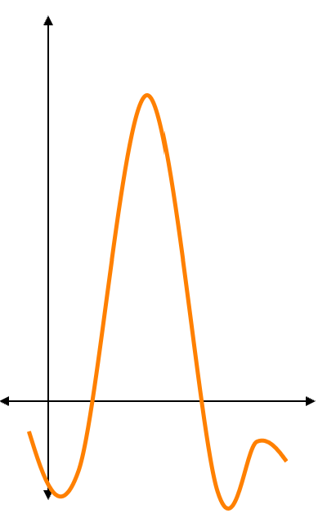






$$Vertical Line Test$$
Ex. 3) Do the Graphs Represent y as a Function of x

Slide 17
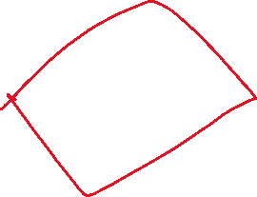









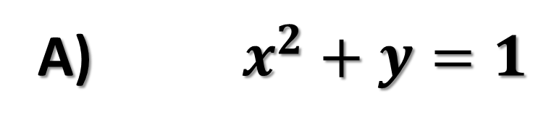








Ex. 4)
Tell whether the equations represent y as a function of x
A) $x^{2}+y=1$
B) $−x+y^{2}=1$

Slide 18
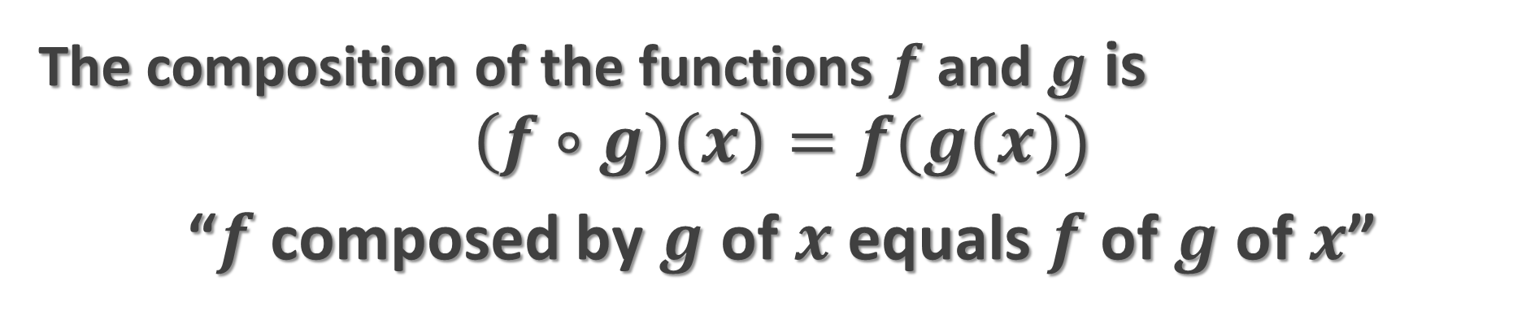
Combinations of Functions
The composition of the functions $f$ and $g$ is
$$\left(f∘g\right)\left(x\right)=f(g\left(x\right))$$
“$f$ composed by $g$ of $x$ equals $f$ of $g$ of $x$”

Slide 19











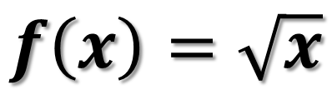

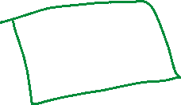




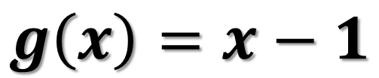






Ex. 5)
$$f\left(x\right)=\sqrt{x}$$
$$g\left(x\right)=x−1$$
FIND: $\left(f∘g\right)\left(2\right)=$
FIND: $\left(f∘g\right)\left(x\right)=$
FIND: $\left(g∘f\right)\left(x\right)=$

Slide 20







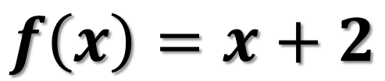



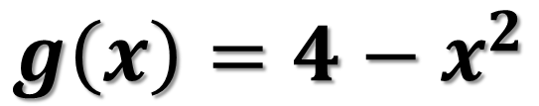





Ex. 6)
$$f\left(x\right)=x+2$$
$$g\left(x\right)=4−x^{2}$$
FIND: $\left(f∘g\right)\left(x\right)=$
FIND: $\left(g∘f\right)\left(x\right)=$

Slide 21
















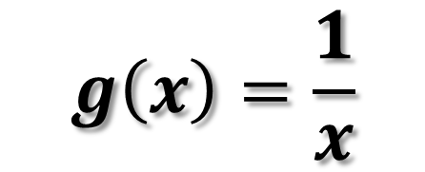









Ex. 7)
$$g\left(x\right)=\frac{1}{x}$$
$$f\left(x\right)=x+2$$
FIND: $f(g\left(x\right))$, g$(f\left(x\right))$ and find the Domain

Slide 22
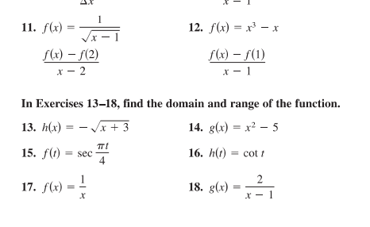

Slide 23
